Slide 1
3D Game Basic
7th class
Unity3d – Material
Handityo aulia putra

Slide 2
Note :
You will need an image editor
That can handle:
- layers
- transparency
PHOTOSHOP / GIMP

Slide 3
Material in Unity [1]
Rendering in Unity uses Materials, Shaders and Textures.
Materials (our focus)
Define how a surface should be rendered
by including references to the Textures it uses, tiling information, Color tints and more
The available options for a Material depend on which Shader the Material is using.
Shaders
small scripts that contain the mathematical calculations and algorithms for calculating the Color of each pixel rendered, based on the lighting input and the Material configuration.
Textures
Bitmap images
A Material can contain references to textures, so that the Material’s Shader can use the textures while calculating the surface color of a GameObject
Shaders
Textures
Material
Model

Slide 4
Material in Unity [2]
How a material is used:
A material specifies one specific Shader to use
The Shader determines which options are available
A Shader specifies one or more Texture variables to use
For most normal/basic rendering the standard Shader is usually the best choice.
Basic/normal rendering, includes:
characters,
scenery,
environments,
solid an transparent Gameobjects,
hard and soft surfaces
Shaders
Textures
Material
Model

Slide 5
Creating Material

Slide 6
Creating Material
Creating a basic material with Standard Shader (Specular setup)
Adapting a basic material from Specular setup to Metallic

Slide 7
Creating Material - Intro
Unity 5 introduces in new Physically-Based Shaders.
Physically-Based Rendering is
a technique that simulates the appearance of materials based on how the light reacts with that material in the real world.
(more specifically, the matter from which that material is made)

Slide 8
Creating Material - Intro
Physically-Based Rendering allows for more realistic and consistent materials.
Unity simplifies the material creation by creating some workflows (Metallic or Specular setup)
Unity optimizes the shader for the created material,
remove unnecessary code for unused properties once the material has been set up and the texture maps have been assigned.

Slide 9
Creating and saving texture maps
The visual aspects of a material can be modified through the use of textures.
In order to create and edit image files,
you will need an image editor such as
Adobe Photoshop (the industry standard, and has its native format supported by Unity),
GIMP (I usedGIMP for the steps in this PPT)
and so on.

Slide 10
Creating and saving texture maps
When saving texture maps,
especially the ones that have an Alpha Channel,
an adequate file format is required.
PSD, Photoshop's native format, is practical for preserving the original artwork in many layers.
The PNG format is also a great option,
but please note that Photoshop doesn't handle PNG's Alpha channel independently of the transparency, possibly compromising the material's appearance.
Also, PNG files don't support layers.

Slide 11
Creating and saving texture maps
For this course, we will often use the TIF format for three main reasons:
(a) it's open to those not using Photoshop;
(b) it uses layers;
(c) it preserves the Alpha Channel information.
The file size is significantly greater than in PSDs and PNGs, so feel free to save your work as
PSDs (if you have Photoshop) or
PNGs (if you don't need layers and, if using Photoshop, Alpha Channels).

Slide 12
Creating and saving texture maps
Unity supports two different workflows:
Specular workflow, and
Metallic workflow.
Although both workflows share similar properties, they differ in the way the diffuse color and reflectance properties are set up.

Slide 13
SPECULAR WORKFLOW

Slide 14
Specular workflow
Unity's Standard Shader (Specular setup) uses
Albedo and
Specular/Smoothness maps,
Unity combine both of them to create some of the material's aspect—mainly its color and reflectance qualities.

Slide 15
Specular workflow - Albedo
Albedo:
This is the material's diffused color.
Plainly and simply, this is how we usually describe the appearance of the material
the British flag is red, white and blue;
Ferrari's logo is a black horse in a yellow setting;
some sunglasses' lenses are semi-transparent gradients, and more.
This description, however, can be deceptive.
Purely metallic objects (such as aluminum, chrome, gold, and others) should have black as their diffuse color.
Their colors, as we perceive them, have originated from their specular channel.
Non-metallic objects (plastic, wood, and even painted or rusted metal), on the other hand, do have very distinct diffuse colors.
Texture maps for the Albedo property feature RGB channels for colors and (optionally) an Alpha Channel for transparency.

Slide 16
Specular workflow - Specular
Specular/Smoothness:
This refers to the shininess of the material.
Texture maps make use of RGB channels for
specular color (which informs hue and intensity), and
Alpha Channel for smoothness/gloss
dark values for less shiny surfaces and blurred reflections;
light/white values for shiny, mirror-like appearance.
It is important to note that
non-metallic objects feature neutral, very dark specular colors
with plastic, for instance, you should work with a grey value around 59.
Metallic objects, on the other hand, feature very light values, and are also a bit yellowish in hue.

Slide 17
METALLIC WORKFLOW

Slide 18
Metallic workflow
Unity's default Standard Shader
combines Albedo and Metallic/Glossiness maps
to create the color and reflectance qualities of the material.

Slide 19
Metallic workflow - Albedo
Albedo:
This is the material's diffused color.
Albedo maps for the Metallic workflow should be configured in a slightly different way than ones for Specular workflow.
This time around, the perceived diffuse color of metallic materials (grey for iron, yellow/ orange for golden, and so on) have to be present in the Albedo map.
Again, Albedo maps feature
RGB channels for the colors and (optionally)
an Alpha channel for transparency.

Slide 20
Metallic workflow - Smoothness
Metallic/Smoothness:
This refers to the shininess of the material.
Metallic texture maps make use of the
Red channel for the Metallic value
Black for non-metallic and
White for metallic materials that are not painted or rusted and
Alpha Channel for smoothness (in a similar way to the Specular workflow).
Please note that Metallic maps do not include any information on hue, and in these cases the yellow-ish nature of the metallic gloss should be applied to the Albedo map.

Slide 21
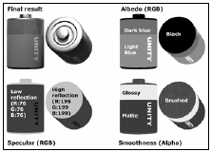
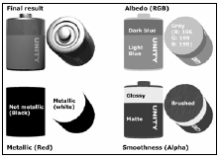
Workflows
Specular
Metallic

Slide 22
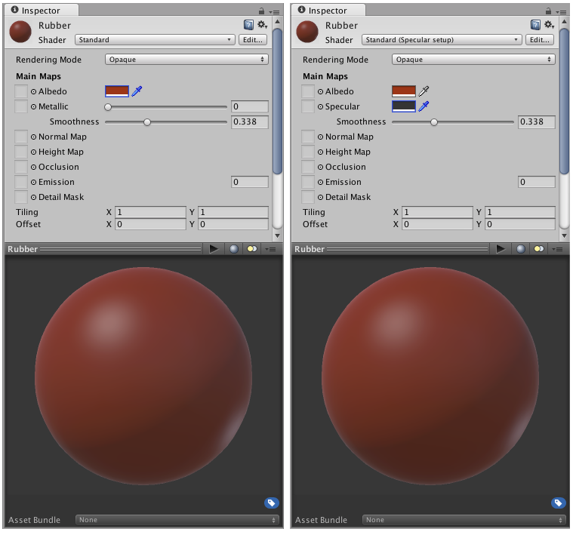
Workflows
Metallic
Specular

Slide 23
OTHER MATERIALS

Slide 24
Other Material Properties [1]
Normal maps:
The normal map adds detailed bumpiness into the material, simulating a more complex geometry.
For instance,
the internal ring on the positive (top) node of the battery that illustrated shader workflows is not modeled in the 3D object's geometry,
but rather created through a simple normal map.
Occlusion maps:
A greyscale map is used to simulate the dark sections of an object under ambient light.
Usually, it is used to emphasize joints, creases, and other details of geometry.

Slide 25
Other Material Properties [2]
Height maps:
These add a displacement effect,
giving the impression of depth without the need for complex geometry.
Emission maps:
These add color emitted by the material,
as if self-illuminated, such as fluorescent surfaces or LCDs.
Texture maps for Emission feature RGB channels for color.

Slide 26
Unity samples and documents
Unity has put together a great resource for those looking for some pointers regarding
how to set up maps for a variety of materials:
featuring sample materials (both Metallic and Specular setup) for
wood, metal, rubber, plastic, glass, skin, mud, and much more.
http://unity3d.com/support/documentation/Manual/Textures.html.

Slide 27
MINI-PROJECTS CLASS 07

Slide 28
Creating Material
Creating a basic material with
Standard Shader (Specular setup)

Slide 29
Creating a basic material with Standard Shader (Specular setup)
In this project, we will learn
how to create a basic material using the new Standard Shader (Specular Setup),
an Albedo map, and
a Specular/Smoothness map.
The material will feature both metallic and non-metallic parts, with various smoothness levels.

Slide 30
Basic Material with Specular Shader - Preparation
Two files have been prepared to support this recipe:
a 3D model (in FBX format) of a battery,
an UVW template texture (in PNG format)

Slide 31

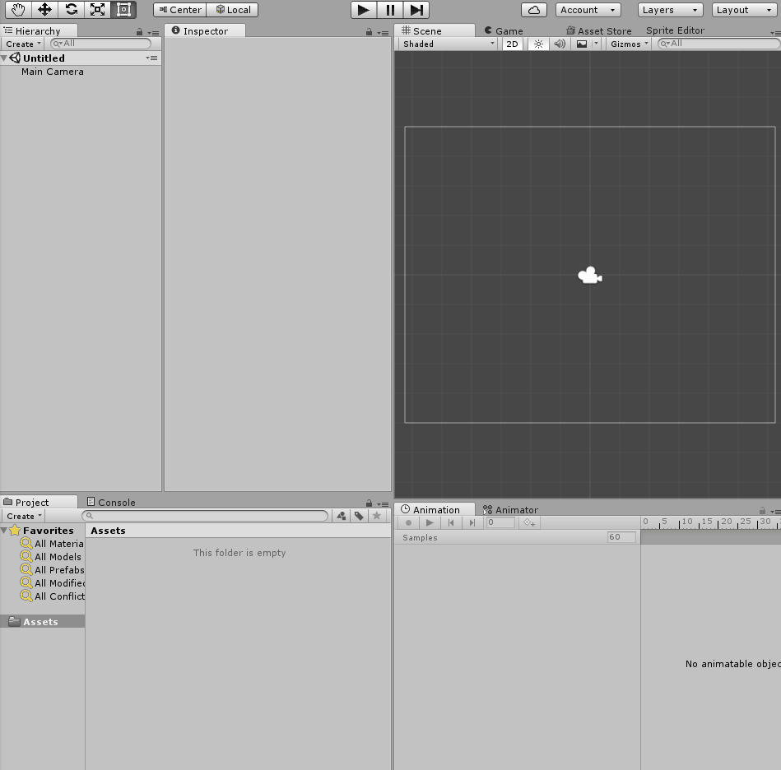
Basic Material with Specular Shader
1. Import the battery.FBX and uvw_template.png files to your project.
2. Place the battery model in the scene by dragging it from the Assets folder, in the Project view, to the Hierarchy view.
Select it on the Hierarchy view and make sure, via the Transform component on the Inspector view, that it is positioned at X: 0, Y: 0, Z: 0.

Slide 32
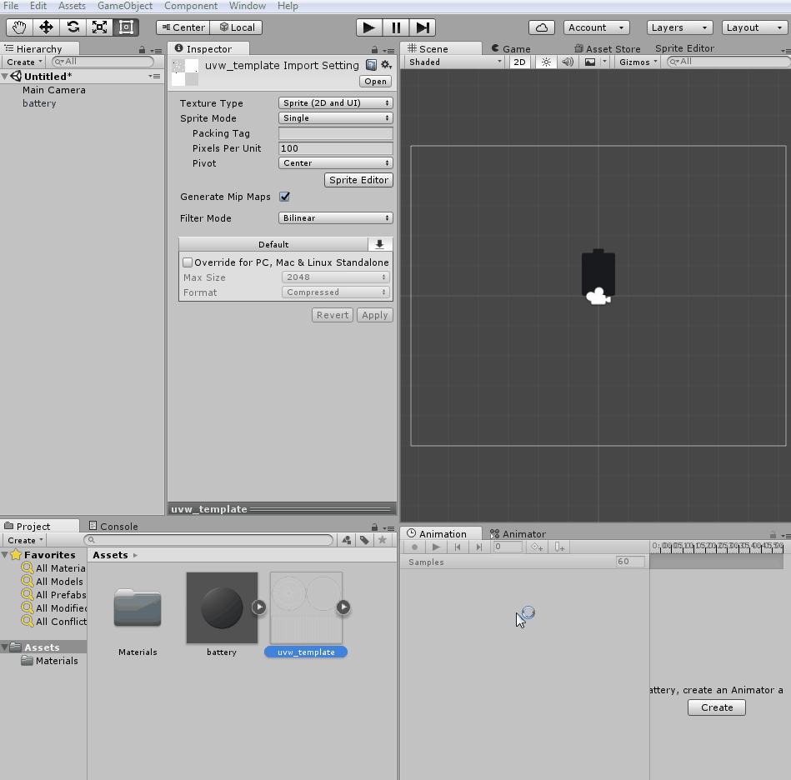
Basic Material with Specular Shader
3. Now, let's create a Specular/ Smoothness map for our object.
Open the image file called uvw_template.png in your image editor.
Note that the image file has only a single layer, mostly transparent, containing the UVW mapping templates that we will use as guidelines for our specular map.

Slide 33
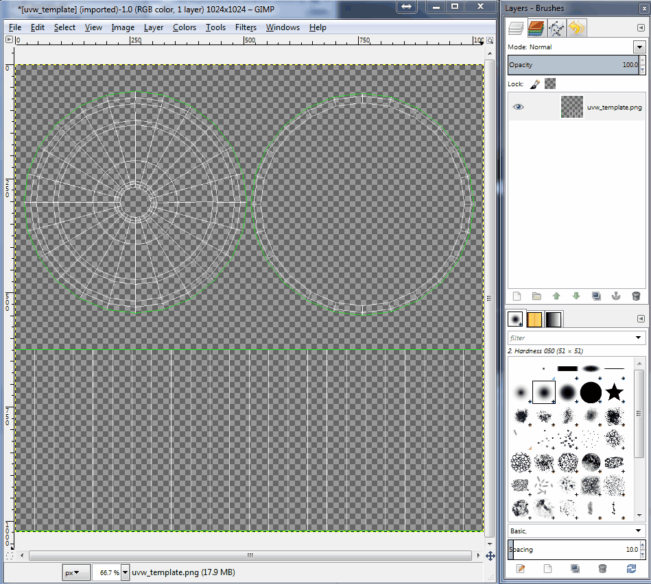
Basic Material with Specular Shader
4. Create a new layer and place it beneath the one with the guidelines.
Fill the new layer with dark gray (R: 56, G: 56, B: 56).
The guidelines will be visible at the top of the solid black fill:

Slide 34
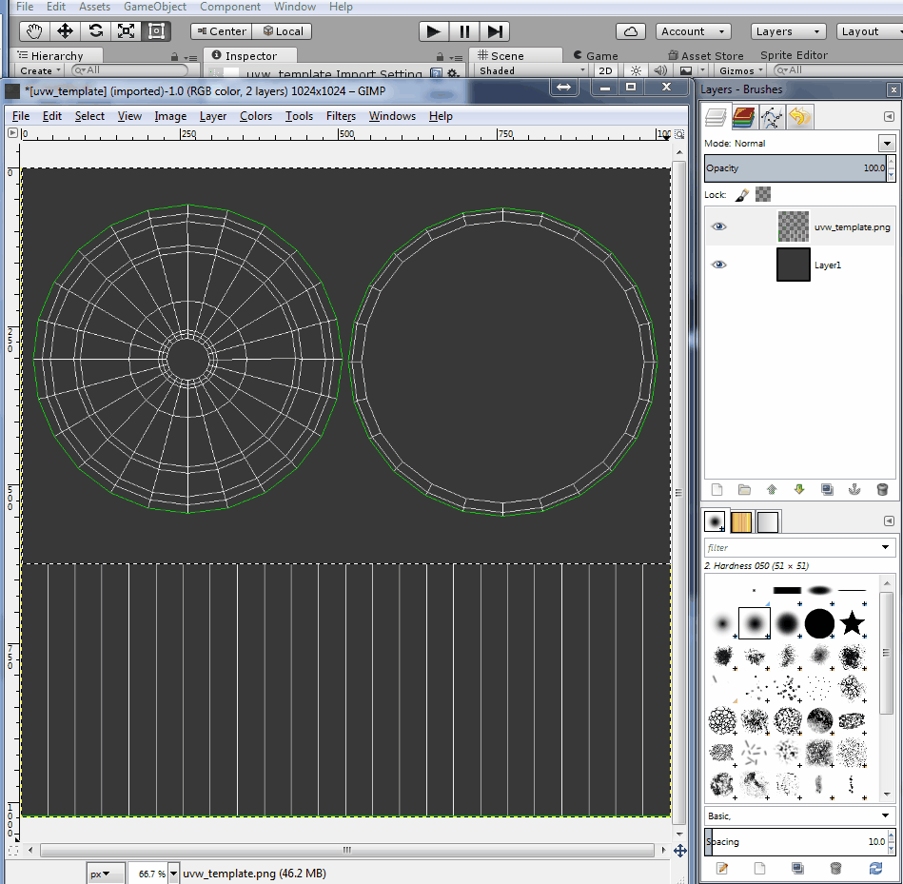
Basic Material with Specular Shader
5. Create a new layer and select the upper section of the image (the one with the circles).
Then, fill that area with a slightly hued light gray
(R: 196, G: 199, B: 199):

Slide 35
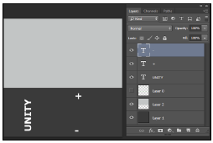
Basic Material with Specular Shader
6. Use the text elements in white to add a brand, size, and positive/negative indicators to the battery body.
Then, hide the guidelines layer.

Slide 36
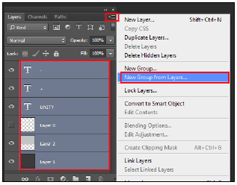
Basic Material with Specular Shader
7. Select all your layers and organize them into a group
(in Photoshop, this can be done by clicking on the drop-down menu in the Layers window and navigating to Window | New Group from Layers…).
Name the new group Specular:

Slide 37
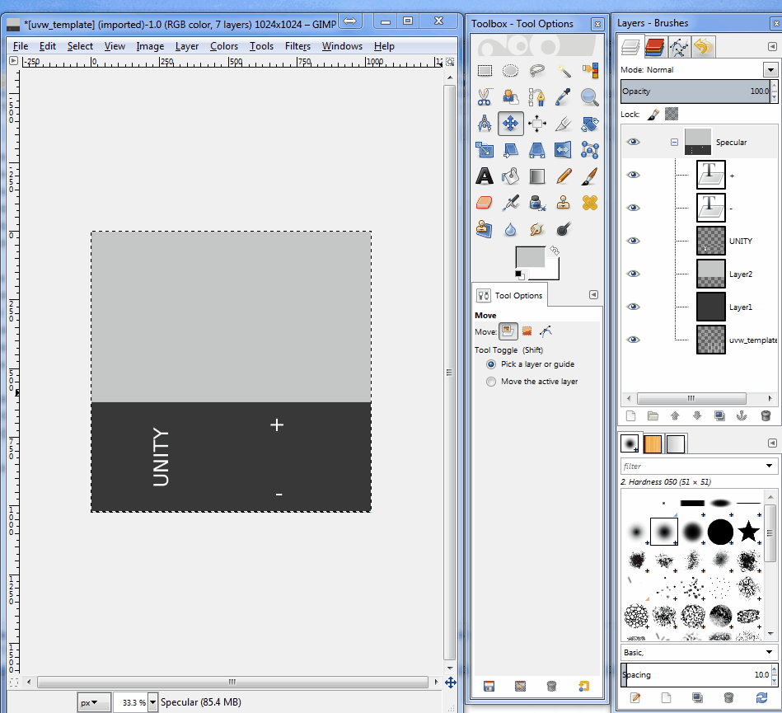
Basic Material with Specular Shader
8. Duplicate the Specular group
(in the Layers window, right-click on the group's name and select Duplicate Group…).
Name the duplicated group Smoothness.

Slide 38
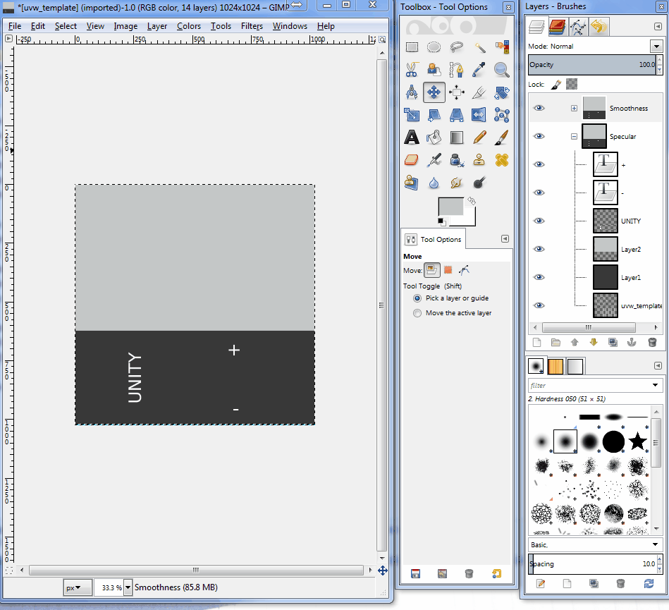
Basic Material with Specular Shader
9. Hide the Smoothness group.
Then, expand the Specular group and hide all text layers:

Slide 39
Basic Material with Specular Shader
10. Unhide the Smoothness group, and hide the Specular group.
Select the dark gray layer.
Then, make an area selection around the upper region of the battery body, and fill it with light gray (R: 220, G: 220, B: 220).
Rescale and rearrange the Text layers if needed:

Slide 40
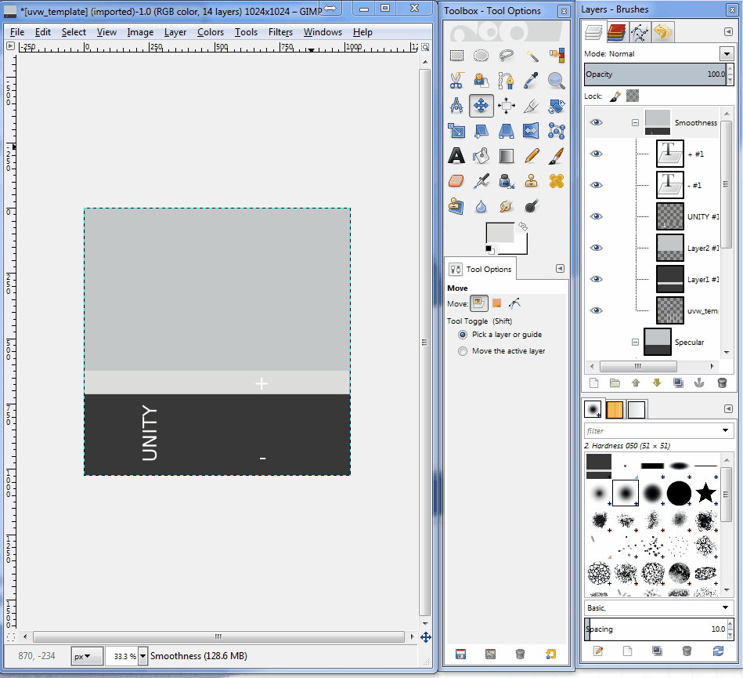
Basic Material with Specular Shader
11. Duplicate the layer that contains the gray fill for the upper section of the image
(the one that went over the circles).

Slide 41
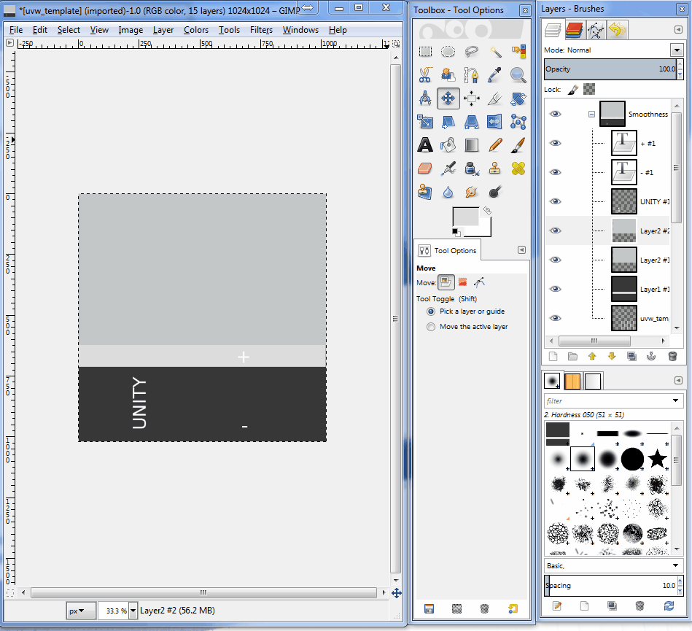
Basic Material with Specular Shader
12. To add a brushed quality to this material, add a Noise filter to the duplicated layer
(in Photoshop, this can be done by navigating to Filter | Noise | Add Noise...).
Use 50% as the Amount and set Monochromatic to true.
Then, apply a Motion Blur filter (Filter | Blur | Motion Blur...) using 30 Pixels as the Distance.

Slide 42
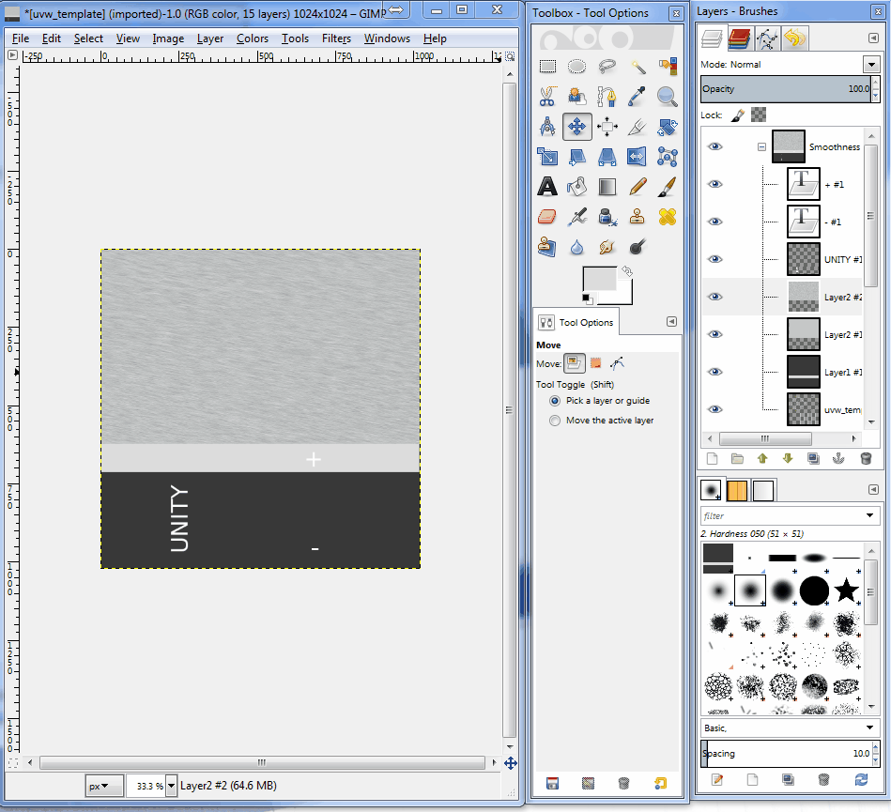
Basic Material with Specular Shader
13. Duplicate the Smoothness group.
Then, select the duplicated group and merge it into a single layer
(on the Layers window, right-click on the group's name and select Merge Group).

Slide 43
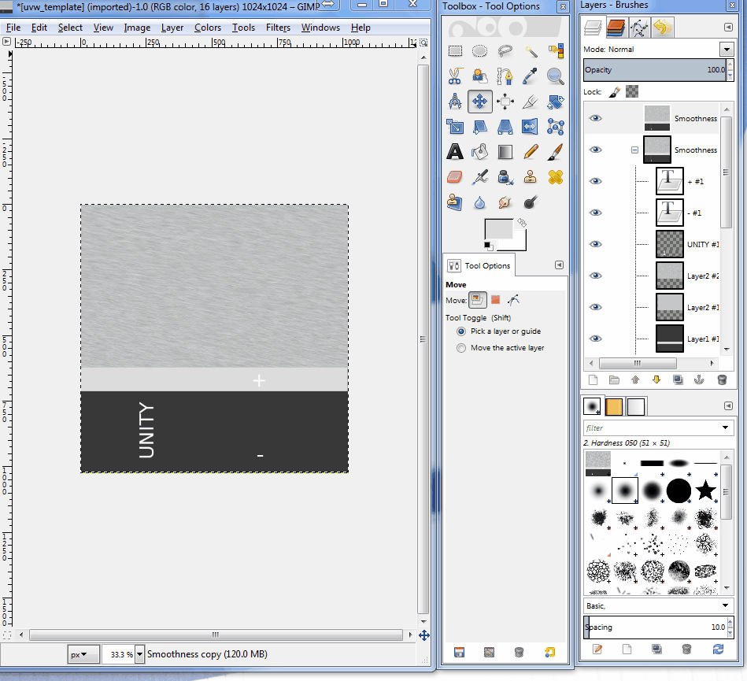
Basic Material with Specular Shader
14. Select the merged layer, use the CTRL + A key to select the entire image, and copy it using the CTRL + C keys:
15. Hide the merged layer and the Smoothness group. Then, unhide the Specular group.
16. In your image editor, access the image channels window (in Photoshop, this can be done by navigating to Window | Channels). Create a New Channel. This will be our Alpha Channel.

Slide 44
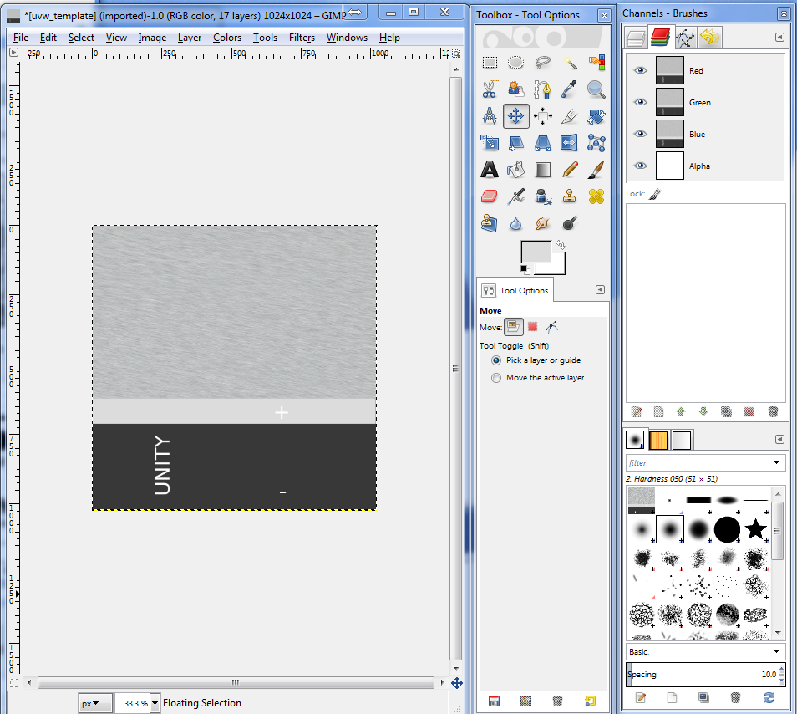
Basic Material with Specular Shader
17. Paste the image that you previously copied (from the merged layer) in to the Alpha Channel.
Then, set all channels as visible:

Slide 45
Basic Material with Specular Shader
17. Paste the image that you previously copied (from the merged layer) in to the Alpha Channel.
Then, set all channels as visible:
18. Save your image in the Project's Assets folder as Battery_specular, either in
Photoshop format (PSD) or TIF format.

Slide 46

Basic Material with Specular Shader
19. Now, let's work on the Albedo map. Save a copy of Battery_specular as Battery_albedo. Then, from the Channels window, delete the Alpha Channel.
20. From the Layers window, hide the Smoothness copy merged layer, and unhide the Smoothness group. Finally, expand the Smoothness group, and hide the layer where the Noise filter was applied:

Slide 47
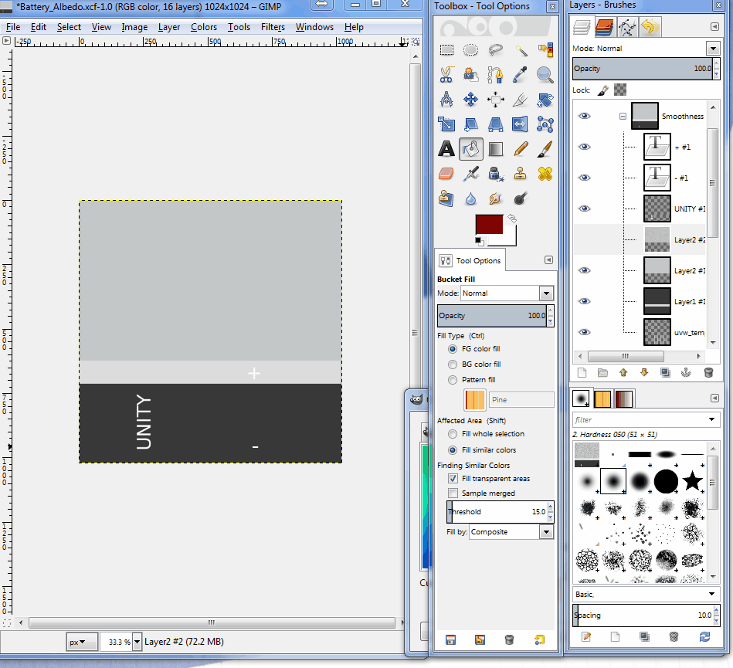
Basic Material with Specular Shader
21. Change the color of the upper rectangle to black. Then, change the light gray area to dark red (R: 204, G: 0, B: 0), and the dark gray to red (R: 255, G: 0, B: 0).
Rename the group Albedo and save the file:

Slide 48
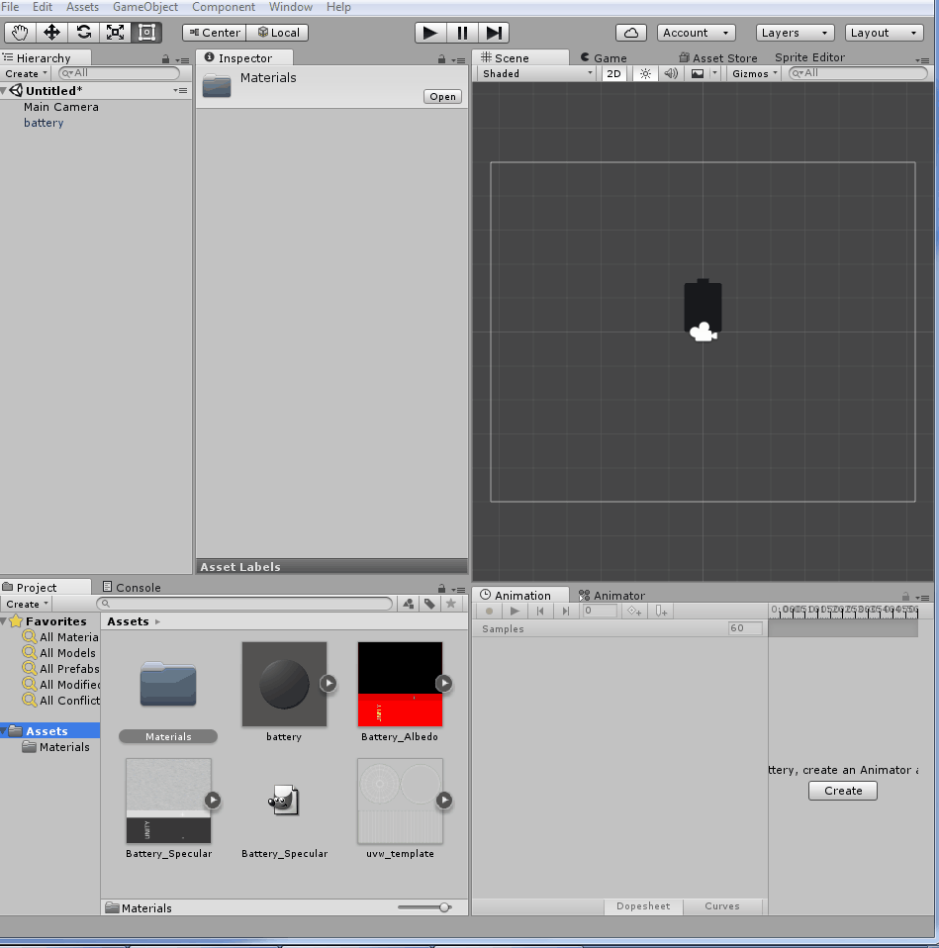
Basic Material with Specular Shader
22. Go back to Unity and make sure that both files were imported.
Then, from the Project view, create a new Material.
Name it Battery_MAT.

Slide 49
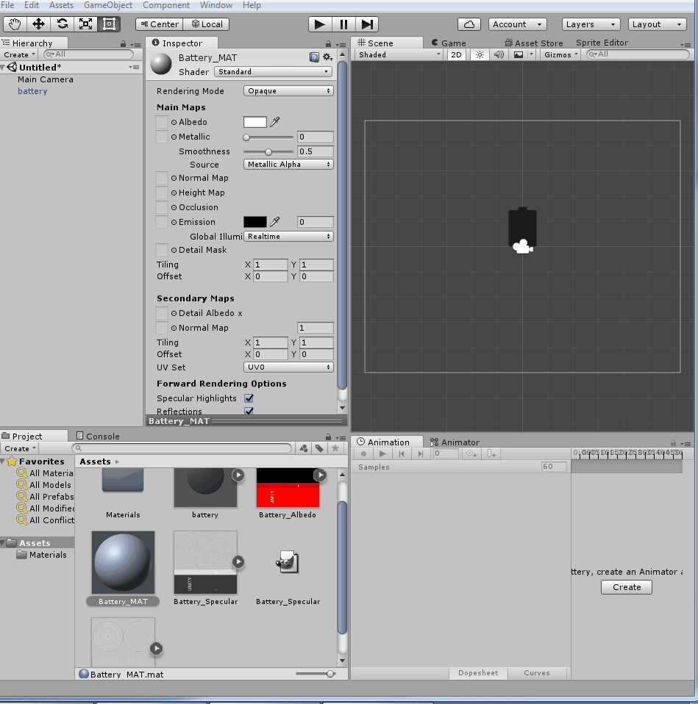
Basic Material with Specular Shader
23. Select Battery_MAT. From the Inspector view, change the Shader to Standard (Specular setup), and make sure that the rendering mode is set to Opaque.

Slide 50
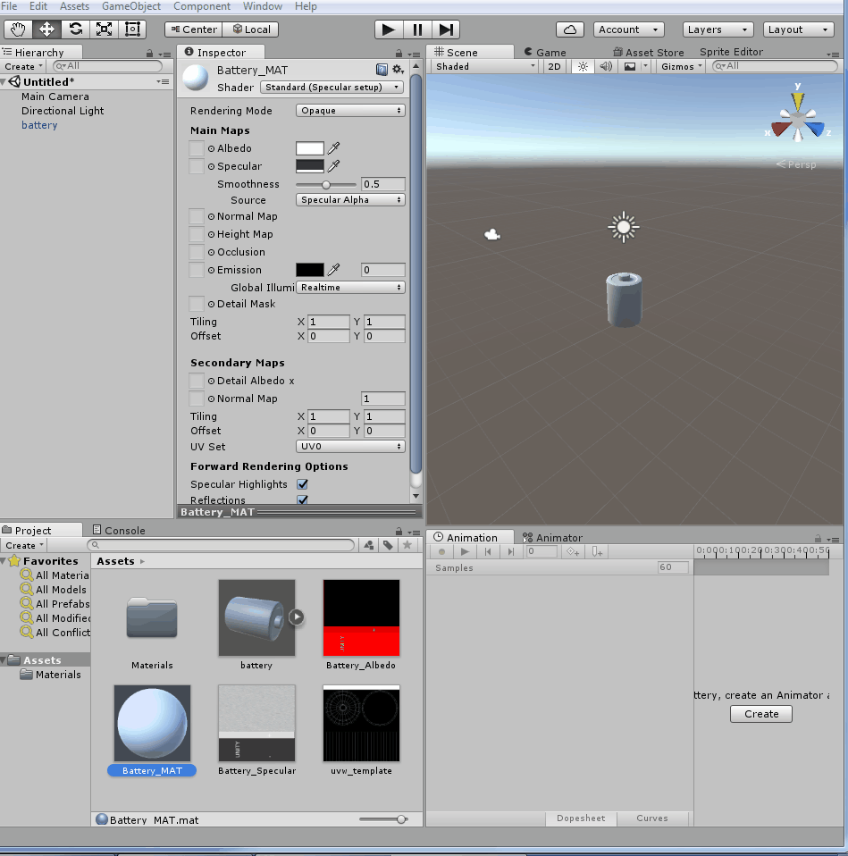
Basic Material with Specular Shader
24. Set Battery_specular as the Specular map, and Battery_albedo as the Albedo map for Battery_MAT.
25. Drag the Battery_MAT material from the Project view and drop it into the battery object in the Hierarchy view:

Slide 51
Basic Material with Specular Shader – How?
To compose the dark red part of the plastic body, for instance, we have mixed the following:
The Specular map (RGB): Very dark grey specularity (for non-metallic appearance)
The Smoothness (the Alpha channel of the Specular map): Light gray (for a glossy aspect)
The Albedo map: Dark red (for a dark red color)

Slide 52
Basic Material with Specular Shader – How?
Ultimately, the visual aspect of the battery is a combination of three properties of its material:
Specular,
Smoothness,
and Albedo.

Slide 53
Basic Material with Specular Shader – How?
The light red portion, on the other hand, combines the following:
The Specular map (RGB): That same dark grey specular
The Smoothness (the Alpha Channel of the Specular map): Dark gray (for a matte aspect)
The Albedo map: Red (for a red color)

Slide 54
Basic Material with Specular Shader – How?
Finally, the brushed metal used for the top and bottom covers combines the following:
The Specular map (RGB): Light grey (for a metallic aspect)
The Smoothness (the Alpha Channel of the Specular map): A blurred grey noise pattern (for a brushed aspect)
The Albedo map: Black (for a red color)

Slide 55
Basic Material with Specular Shader – How?
Regarding how the image layers are structured,
it's good practice to organize your layers into groups named after the property that they are related to.
As texture maps get more diversified, it can be a good idea to keep a file that contains all the maps for quick reference and consistency.

Slide 56
Basic Material with Specular Shader – How?
A few things you should have in mind when working with Albedo maps are as follows.
Setting the texture type for an image file
Since image files can be used for several purposes within Unity (texture maps, GUI textures, cursors, and more), it's a good idea to check if the right Texture Type is assigned to your file.
Combining the map with color
When editing a material, the color picker to the right of the Albedo map slot, on the Inspector view, can be used to select the material's color, in case there is no texture map.
If a texture map is being used, the selected color will be multiplied to the image, allowing variations on the material's color hue.

Slide 57
Adapting a basic material from Specular setup to Metallic

Slide 58
Adapting a basic material from Specular setup to Metallic
For a better understanding of the differences between Metallic and Specular workflows,
we will modify the Albedo and Specular/Smoothness maps that are used on a Specular setup material, in order to adapt them to the Metallic workflow.
The material to be generated will feature both metallic and non-metallic parts, with various smoothness levels.

Slide 59
Adapting a basic material from Specular setup to Metallic
For this project, a Unity package containing a battery model and its original material (made with Standard Shader—Specular setup) are prepared.
The package includes two image files for
the original Albedo and
Specular/Smoothness maps which should be adapted for use with the Metallic setup.
The package is available in the 1362_07_02 folder.

Slide 60
Adapting a basic material from Specular setup to Metallic

Slide 61
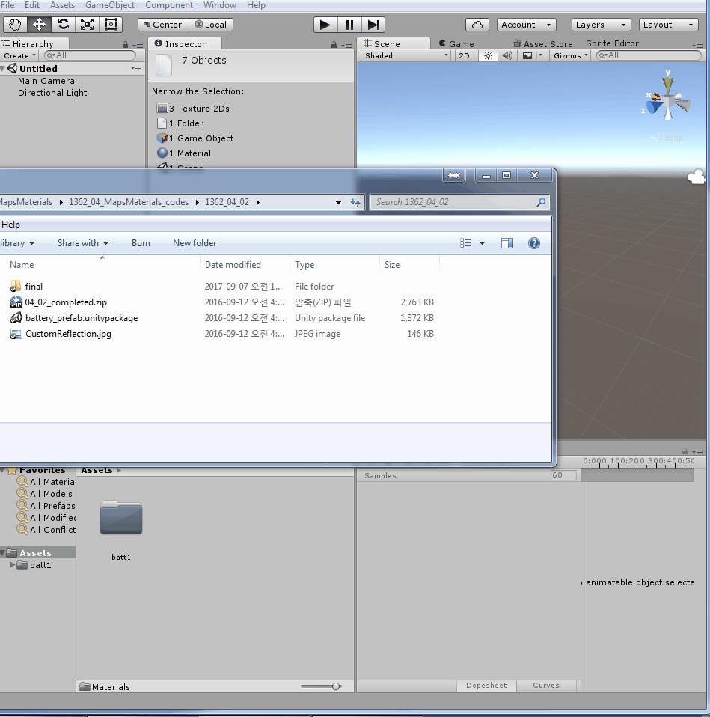
Adapting a basic material from Specular setup to Metallic
1. Import the battery_prefab Unity package into a new project.
2. From the Project view, select the battery_prefab element.
Then, from Inspector, access its material (named Battery_MAT) and change its Shader to Standard
(as opposed to its current shader—Standard (Specular setup).

Slide 62
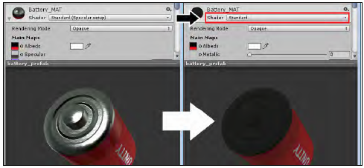
Adapting a basic material from Specular setup to Metallic

Slide 63
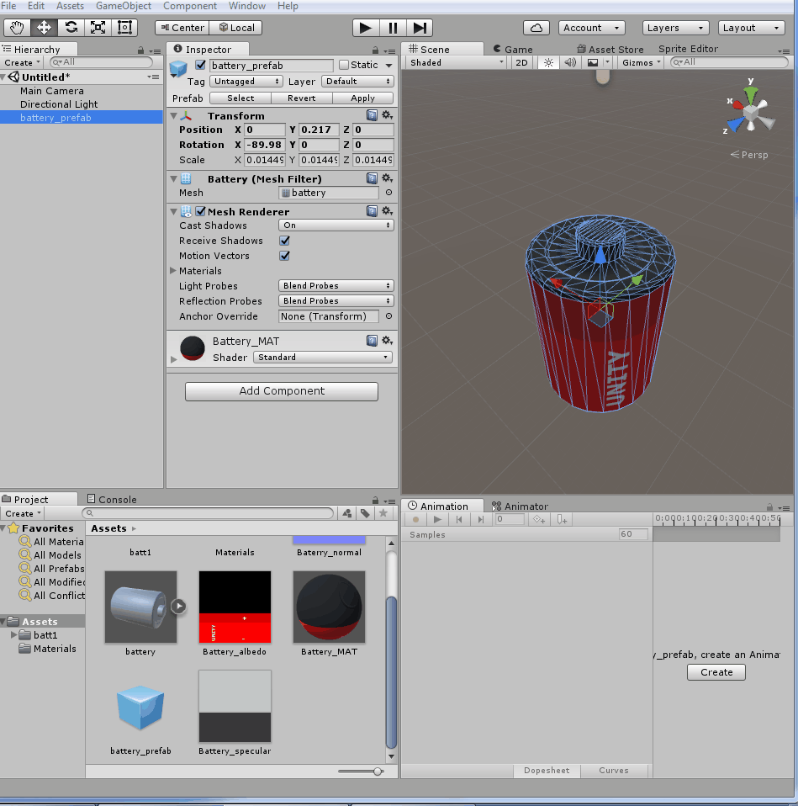
Adapting a basic material from Specular setup to Metallic
3. From the Project view, find the Battery_specular map and rename it Battery_metallic.
Open it in your image editor (we'll use Adobe Photoshop or GIMP to illustrate the following steps).

Slide 64
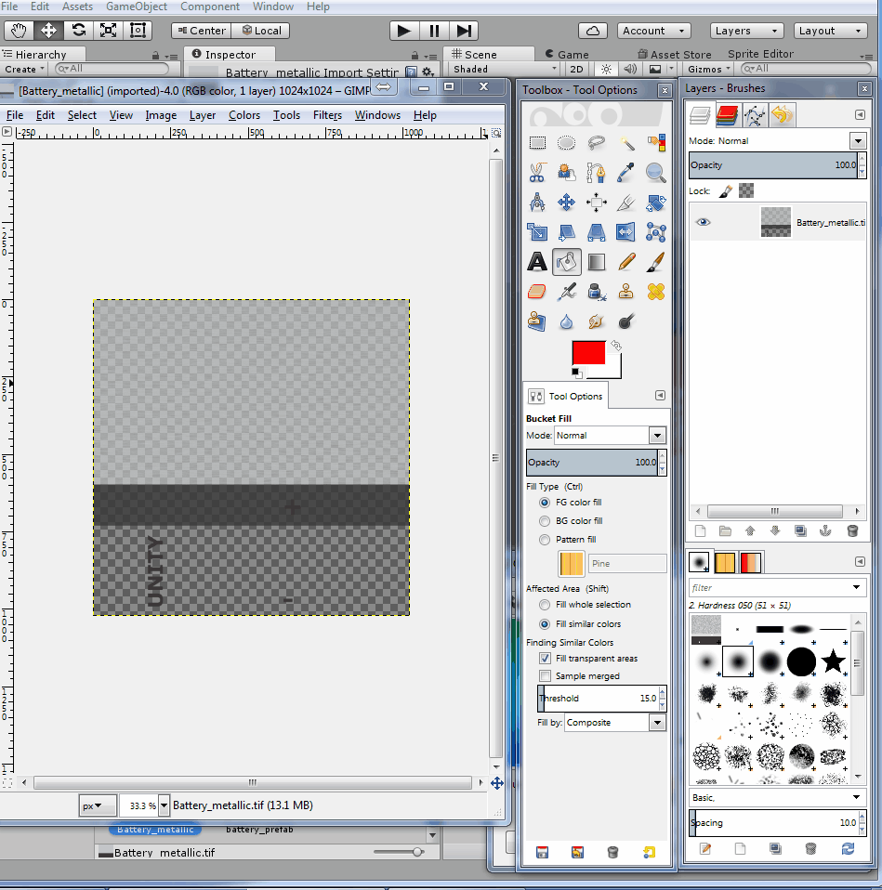
Adapting a basic material from Specular setup to Metallic
4. Find the layer group named Specular and rename it Metallic.
Then, fill the light gray layer (named Layer 2, in the Metallic group) with white (R: 255, G: 255, B: 255), and the dark gray layer (named Layer 1, in the Metallic group) with black (R: 0, G: 0, B: 0).
Save the file:

Slide 65
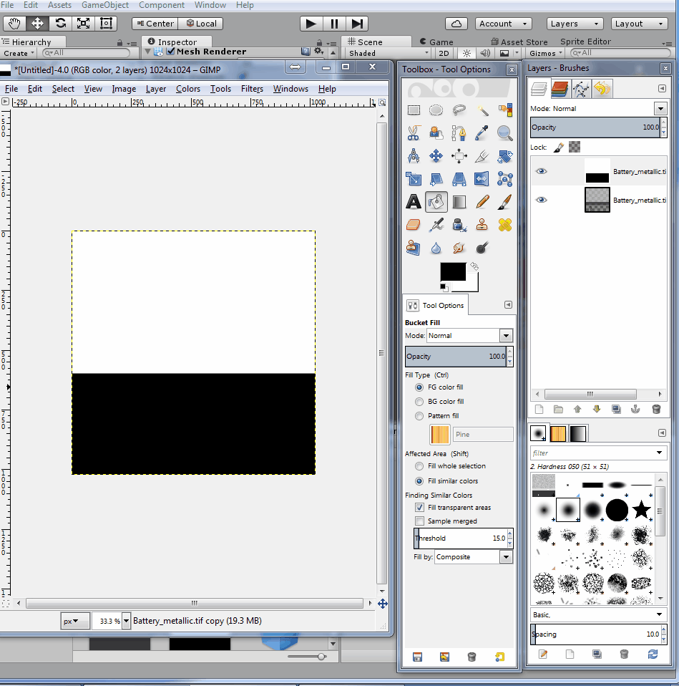
Adapting a basic material from Specular setup to Metallic
5. Go back to Unity.
From the Inspector view, set the modified Battery_metallic map as the Metallic map of the Battery_MAT material.
Also, set None as the Albedo map for that material. This will give you an idea of how the material is coming along:

Slide 66
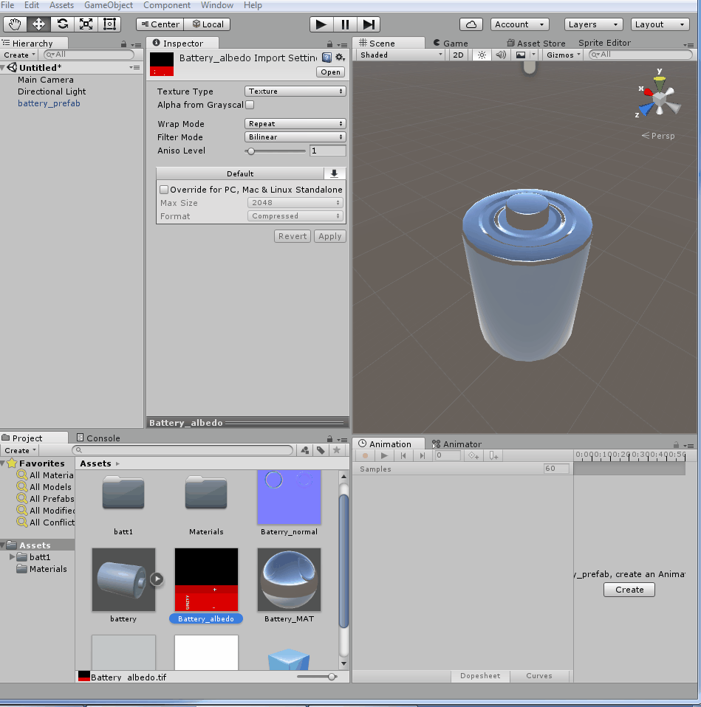
Adapting a basic material from Specular setup to Metallic
6. Now, let's adjust the Albedo texture map.
From the Project view, locate the Battery_albedo map and open it in your image editor.
Then, use the Paint Bucket tool to fill the black area of Layer 2, in the Albedo group, with light gray (R: 196, G: 199, B: 199).
Save the file:

Slide 67
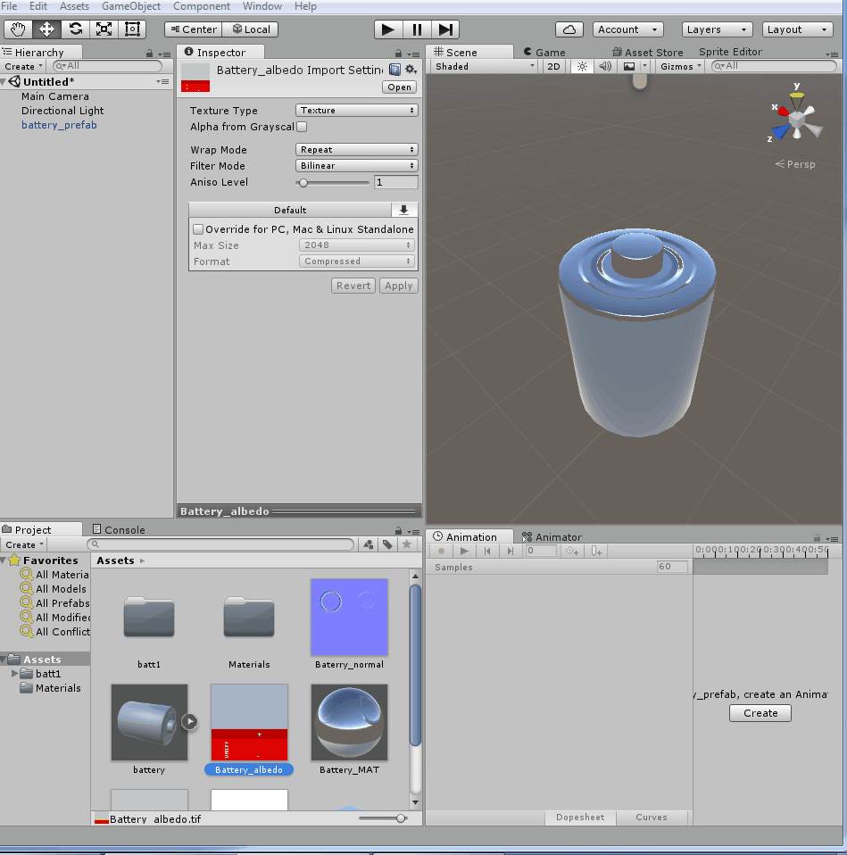
Adapting a basic material from Specular setup to Metallic
7. Go back to Unity.
From the Inspector view, set the modified Battery_albedo map as the Albedo map of the Battery_MAT material.

Slide 68
Adapting a basic material from Specular setup to Metallic
The visual aspect of the battery is a combination of three properties of its material:
Metallic,
Smoothness, and
Albedo.

Slide 69
Adapting a basic material from Specular setup to Metallic
To compose the dark red part of the plastic body, for instance, we have mixed the following:
The Metallic map (RGB): Black (for a non-metallic appearance)
The Smoothness (the Alpha Channel of a Metallic map): Light gray (for a glossy appearance)
The Albedo map: Dark red (for a dark red color)

Slide 70
Adapting a basic material from Specular setup to Metallic
The light red portion, on the other hand, combines the following:
The Metallic map (RGB): Black
The Smoothness (the Alpha Channel of the Metallic map): dark gray (for a matte appearance)
Albedo map: red (for a red color)

Slide 71
Adapting a basic material from Specular setup to Metallic
Finally, the brushed metal used for the top and bottom covers combines the following:
The Metallic map (RGB): white (for a metallic aspect)
The Smoothness (the Alpha Channel of the Metallic map): blurred grey noise pattern (for a brushed appearance);
Albedo map: light grey (for an iron-like appearance)

Slide 72
Applying Normal maps to a material

Slide 73
Applying Normal maps to a material
Normal maps are generally used to simulate complex geometry that would be too expensive, in terms of computer processing, to be actually represented by the 3D polygons during the game's runtime.
Oversimplifying, Normal maps fake complex geometry on low-definition 3D meshes.
These maps can be generated either by projecting high-definition 3D meshes onto low-poly ones (a technique usually referred to as baking), or, as will be the case for this recipe, from another texture map.

Slide 74
Applying Normal maps to a material
For this project, we will prepare two texture maps: the Heightmap and the Normal map.
The former will be made from simple shapes in an image editor.
The latter will be automatically processed from the Heightmap.
Although there are a number of tools that can be used to generate Normal maps, we will use a free online tool, Windows and Mac compatible, to generate our texture.
Developed by Christian Petry, the NormalMap Online feature can be accessed at http://cpetry.github.io/NormalMap-Online/.

Slide 75
Applying Normal maps to a material
To help you with this recipe,
it's been provided a Unity package, containing a prefab made of a 3D object and its material;
an UVW template texture (in PNG format) to guide you when creating the diffuse texture map.
All the files are in the 3DGB-Class07_03_normalMap folder.

Slide 76
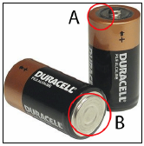
Applying Normal maps to a material
1. Import the 07_03_normal.unitypackage file to your project.
Select the batteryPrefab object from the Assets | 07_03_normal folder, in the Project view.
After comparing it with some reference photos, inform yourself about the features that should be reproduced by the Normal map:
(A) a bumpy ring at the top; and
(B) some circular creases at the bottom, shown in the following image:

Slide 77
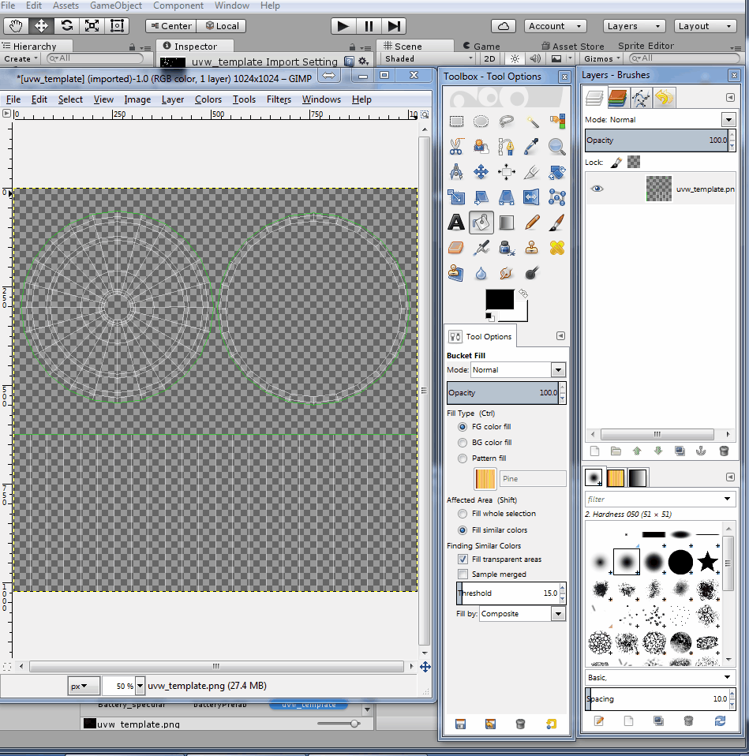
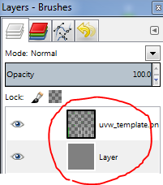
Applying Normal maps to a material
2. In an image editor,
open uvw_template.png.
Create a new layer,
fill it with grey (RGB: 128), and
position it below the pre-existing layer

Slide 78
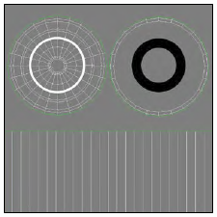
Applying Normal maps to a material
3. On a separate layer,
draw a white circle centered on the battery's top.
Then, on another layer,
draw a black circle, centered on the battery's bottom,

Slide 79
Applying Normal maps to a material
4. If you have used vector shapes to make the circles, rasterize their layers
(in Adobe Photoshop, right-click on the layer's name and select the Rasterize Layer option from the context menu).

Slide 80
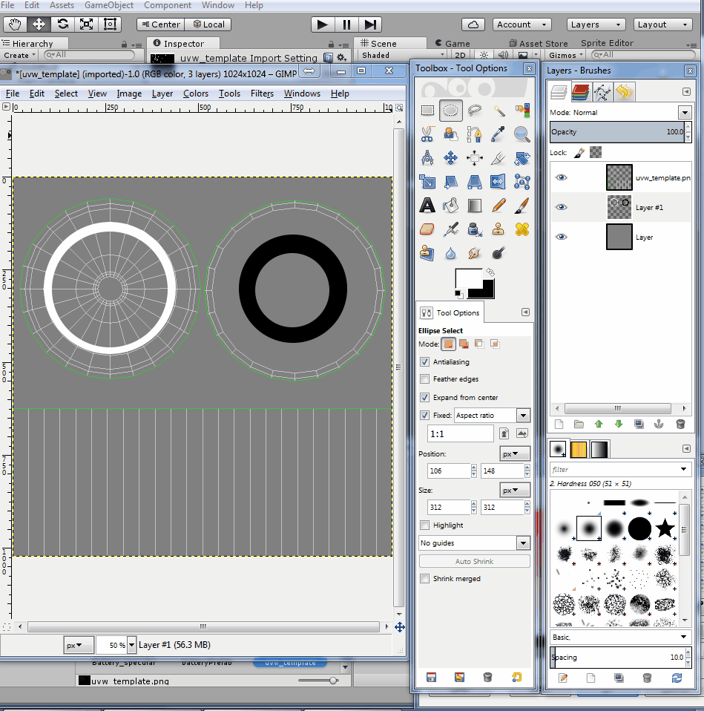
Applying Normal maps to a material
5. Blur the white circle (in Photoshop, this can be done by navigating to Filter | Blur | Gaussian Blur...).
Use 4,0 pixels as the Radius.

Slide 81
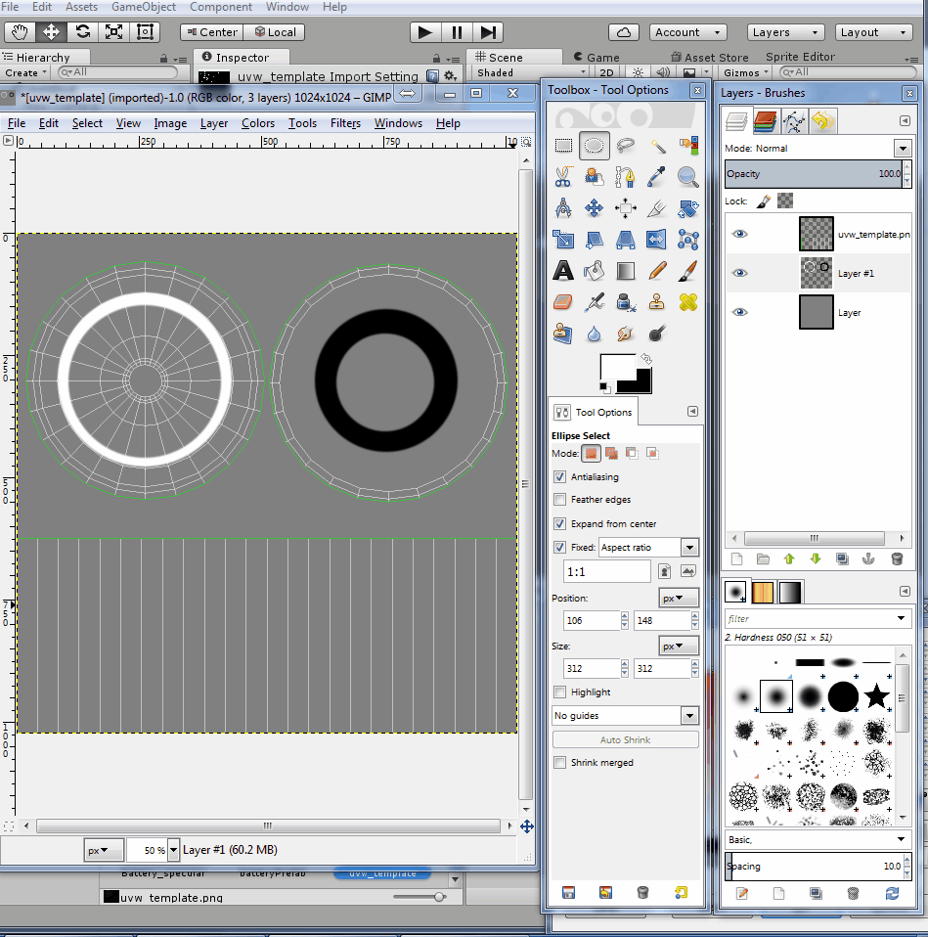
Applying Normal maps to a material
6. Hide the UVW template layer and save the image as Battery_height.png.

Slide 82
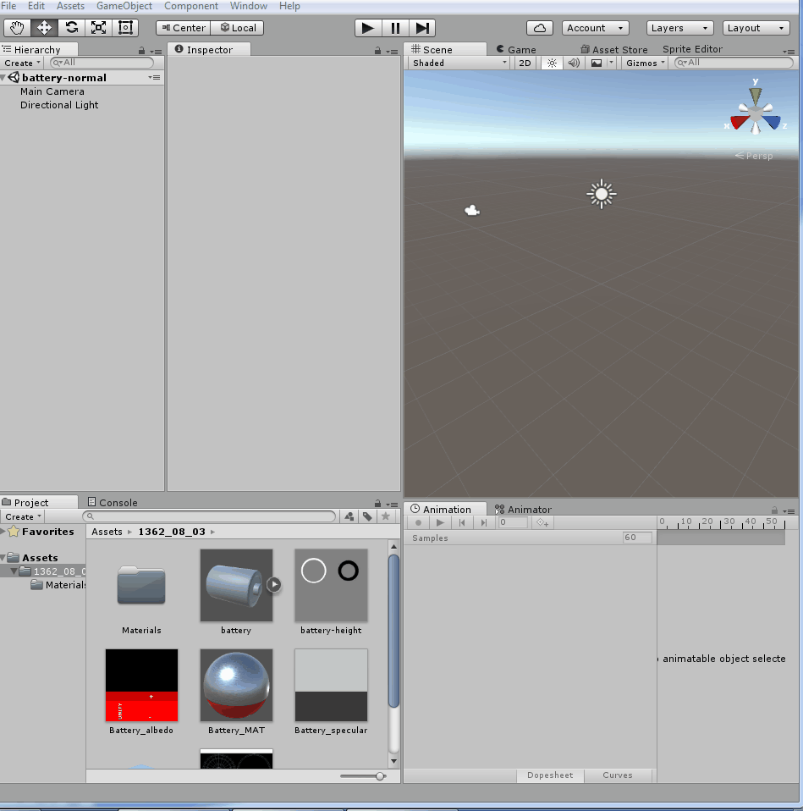
Applying Normal maps to a material
7. If you want to convert the Heightmap directly from Unity, import it to your project.
Select it from the Project view and, from the Inspector view, change its Texture Type to Normal map.
Check the Create from Grayscale option, adjust Bumpiness and Filtering as you like, and click on Apply to save the changes:

Slide 83
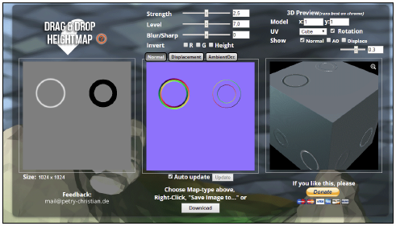
Applying Normal maps to a material
8. To convert your Heightmap externally, access the website at http://cpetry.github.io/NormalMap-Online/.
Then, drag the HEIGHT_battery.png file to the appropriate image slot.
Feel free to play with the Strength, Level and Blur/Sharp parameters:

Slide 84
Applying Normal maps to a material
9. Save the resulting Normal map as Battery_normal.jpg and add it to your Unity project.

Slide 85
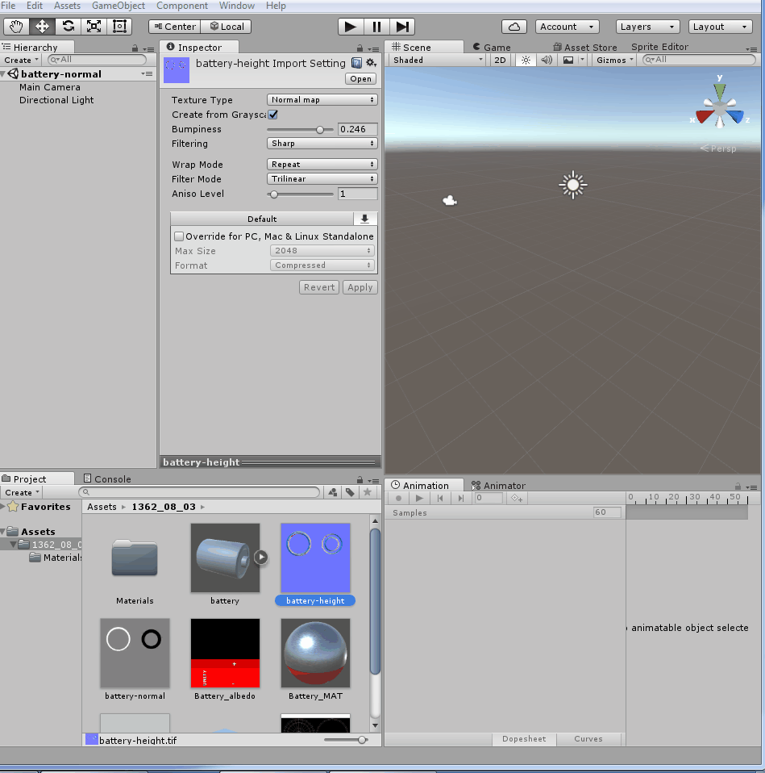
Applying Normal maps to a material
10. In Unity, select Battery_normal from the Project view.
Then, from the Inspector view, change its Texture Type to Normal, leaving the Create from Grayscale box unchecked.
Click on Apply to save the changes:

Slide 86
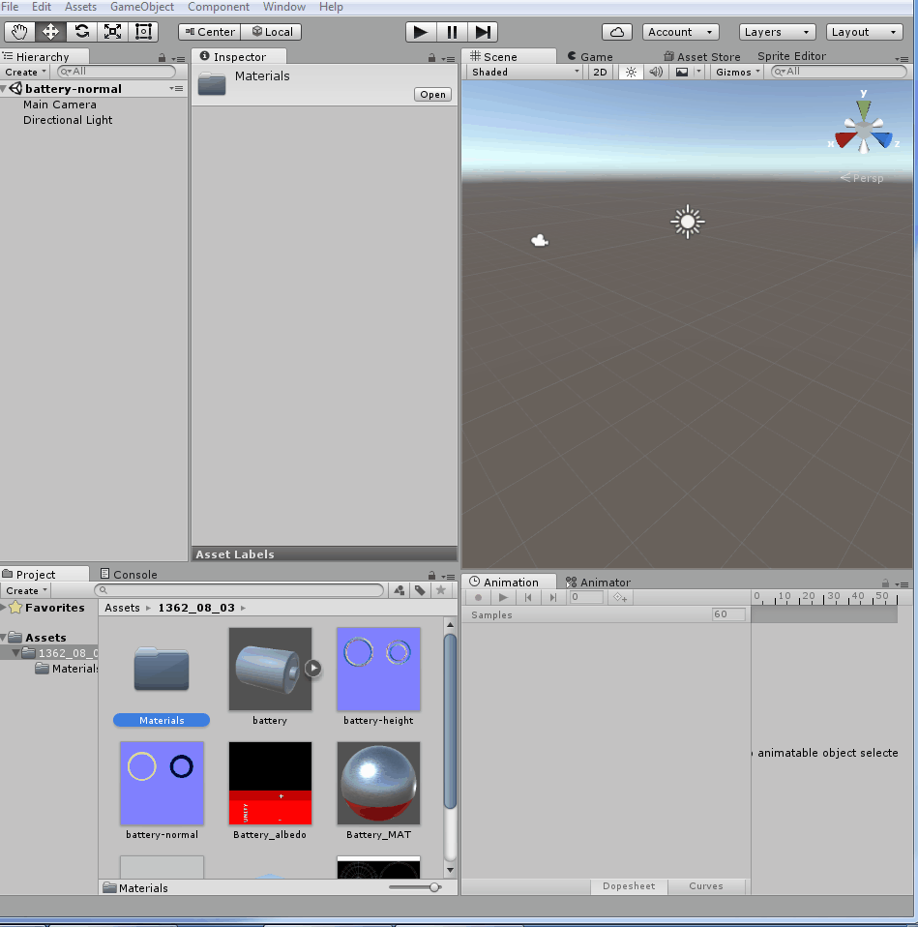
Applying Normal maps to a material
11. In the Project view, select batteryPrefab.
Then, in the Inspector view, scroll down to the Material component, and assign Battery_normal to the Normal Map slot.
Battery-Albedo to Albedo
Battery-specular to specular

